Slide 1
Don’t be the Crazy Chicken!
Wholistic Needs of the Teachers
Or
Susan Labadi
Photo credit: Flickr Rob Bixby

Slide 2
It’s Tough to be Muslim…
Let’s face it…
These days…
Photo Credit: Flickr-Alexander Day

Slide 3
Wholistic vs Holistic
The two words have very distinct meanings though somewhat similar in definition. Wholistic refers to the whole, a whole item or whole body of a person or thing. The word defines the consideration of the entire structure or makeup, which includes the body, mind and the spirit in the case of a human being.
The word holistic is connected to holism, which focuses on the total entity and the interdependence of the diverse parts of this totality. Holistic has to do with the healing systems that are considered alternative like homeopathy and Ayurveda that deal with the human body as an interconnected whole.
http://english.stackexchange.com/questions/139505/wholistic-vs-holistic

Slide 4
Wholistic vs Holistic
Wholistic - parts
Holistic - systems
Mind
Body
Spirit
Ayurvedic
Homeopathy
Naturopathy

Slide 5
Let’s Get Acquainted!

Slide 6
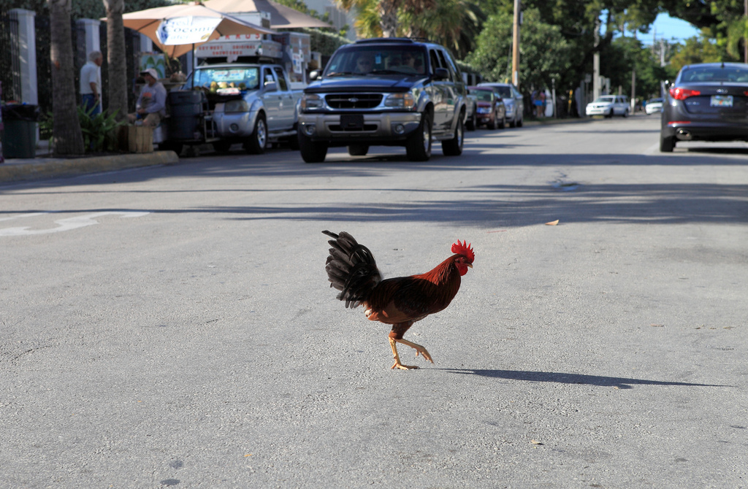
WHY?
Photo Credit: Flickr-Sam Howzit
What Did You Hope to Gain Today?

Slide 7
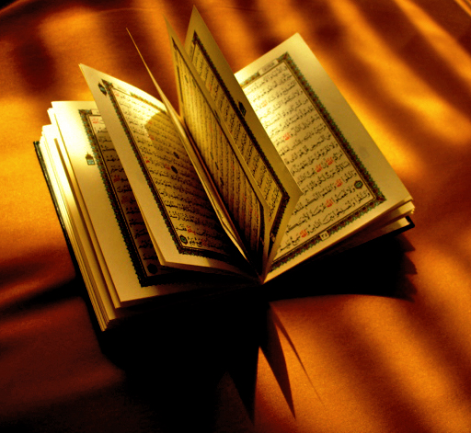
“God does not change the condition of a people unless they change what is in themselves.” (13:11)
We are capable and responsible for our choices
Photo credit: Flickr el7bara

Slide 8
How NOT to be the Crazy Chicken!
Seek guidance from Islam
Acquire a grasp of research
Develop a vision and plan
Create strategies for implementation toward personal and professional reform
Spiritual
Physical
Emotional
Intellectual

Slide 9
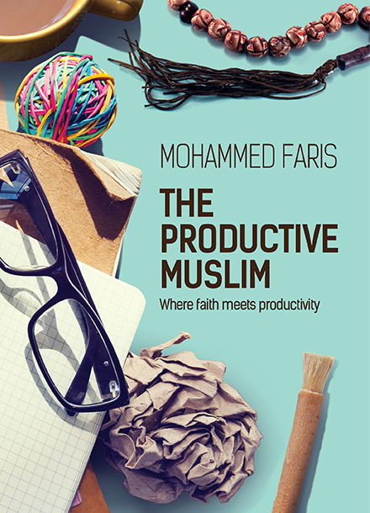
“Yes, we’ve boosted our productivity as a human race but we’ve also lost three things along the way: our purpose, our values, and our soul. As humans, we’re treating ourselves (and other human beings) as soul-less machines whose whole purpose is to work. We’ve focused on what improves the functions of the body (nutrition, fitness, and sleep) and the mind (focus, creativity, and time management) and neglected the values that nourish our soul.”

Slide 10
Accepting our original role as slaves of Allah is fundamentally important to being a healthy, productive citizen of the world.
Without this acceptance, you risk selling yourself, your values, and your soul to a small or big business that simply wants to extract the most out of you regardless of the impact on your health, your family, and/or your society.
The more you think about this concept of being a slave to Allah and its relationship to productivity, the more you realize how crucial it is to living a truly productive life.

Slide 11
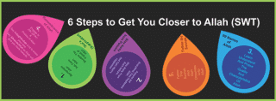
[The Productive Muslim]
Productivity = Focus x Energy x Time

Slide 12
“God will find a way out for those who are mindful of him, and will provide for them from an unexpected source.” (65:2-3) “If you are thankful, I will give you more.” (14:7)
Photo credit: Flickr SNAP®

Slide 13
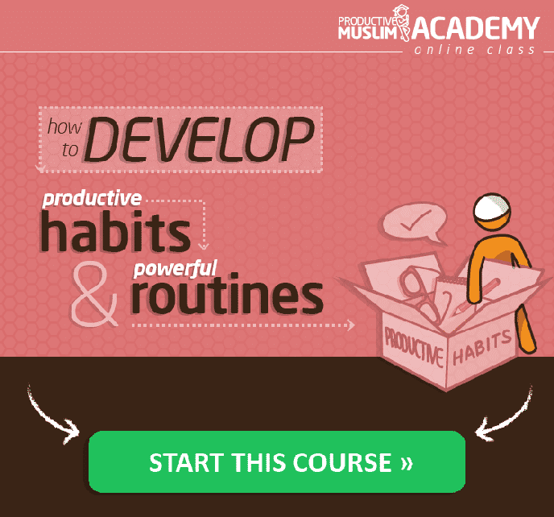
Barakah as related to a spiritual motivation and the divinely gifted energy to accomplish things. We know that all energy comes from The Divine; and when we acknowledge this and ask for His help, we may be given the key to access this energy as the means to service our performance of noble work. Although we do what we can to support our good health and harmony with all things, it is only from Allah that all power is given.

Slide 14
Take a Moment Now
Photo Credit: Flickr-Iqbal Osman

Slide 15
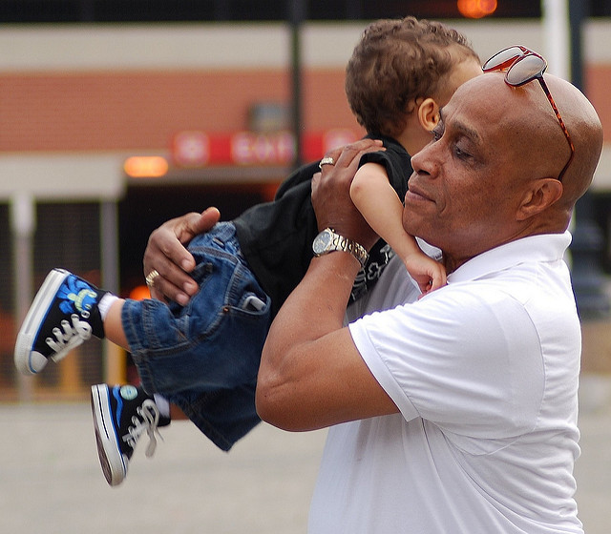
Spiritual Self Check-up
Our sins sap us of our strength and energy
Photo Credit-Flickr:Jackie Finn-Irwin

Slide 16
Want more energy? Do something good for someone
According to researcher Dr. Suzanne Richards, University of Exeter Medical School, volunteers had
Greater life expectancy
Lower depression
More happiness
www.sciencedaily.com/releases/2013/08/130822194451.htm

Slide 17
Rx for a Cure
When you feel blue or depressed, try to sincerely
Ask for Forgiveness
and note a lifting of the mood.
.
Photo credit: Flickr Duncan Hull

Slide 18
“The word halal is roughly translated to ‘permissible’ or ‘lawful’ and it encompasses all areas of life—not just food!
A Muslim is supposed to earn halal income, eat and drink from halal sources, be entertained in a halal way, watch what is halal, and so on.
Living a halal lifestyle therefore is the spiritual focus of our day-to-day actions.”
--Mohammad Faris

Slide 20
What can you do to live and teach a
More HALAL Lifestyle?

Slide 21
“Nothing is sweeter than 2 rakat in the night.”
Ismail Abdel-Qader Labadi

Slide 22
Spiritual Physical
The Prophet said, “If anyone continually asks forgiveness from Allah, Allah will appoint for him a way out of every distress, and a relief from every anxiety, and will provide for him from where he did not reckon.” [Abu Dawud]

Slide 23
INTENT
What is your PURPOSE in LIFE?

Slide 24
Self-Care
We Give…and are vulnerable to “Compassion Fatigue” RECHARGE!
Photo Credit:Flickr-Sacha Chua

Slide 25
Design Your Optimal Conditions
It’s up to YOU…
Photo Credit: Flickr-Juhan Sonin

Slide 26
Develop Self Awareness
Give Yourself the Gift of Time Everyday
Photo Credit: Flickr-Ashiful Haque

Slide 27
Clarify Your Boundaries
And Articulate Them
Photo Credit: Flickr-Ashiful Haque

Slide 28
Strive for Calm
Keep Allah in Mind
Photo Credit: Flickr-Nick Kendrick

Slide 29
Don’t Stress Over Time
But Don’t Waste it Either
Photo Credit: Flickr-Tanti Ruwani

Slide 30
Pause to REFLECT
How Can You Prevent Derailment and Distractions?
Students
Supervisors
Family

Slide 31
Respecting
Photo Credit: Flickr-Jon Feinstein

Slide 32
Nasa Scientist reveals: You must stand up at least 32x a day
Teach this to students too!

Slide 33
What can you do to share this with others?
What changes will YOU make?

Slide 34
Running? Walking or Other?
Care to share other apps or tactics?

Slide 35
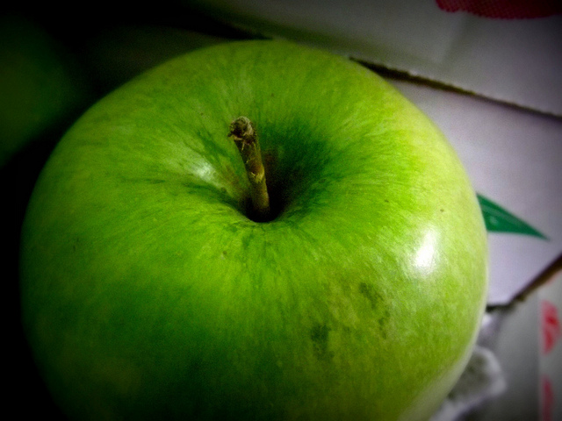
Photo Credit: Flickr-Patsy M_

Slide 36
Mercola.com
Site has a great search engine!

Slide 37
What commitment will you make to preserve/improve your health?
Community
Students
Family
Self
Handout Alert

Slide 38
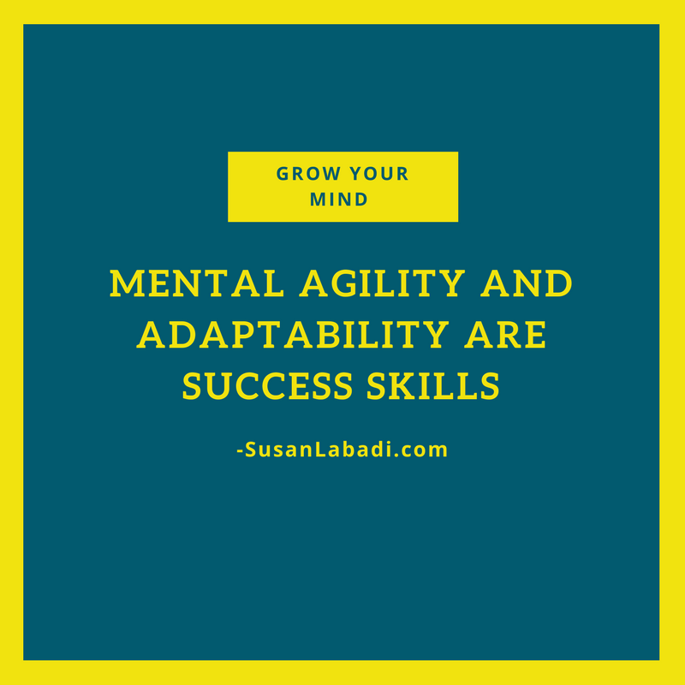

Slide 39
Recommended Book
Are we investing in our own growth? Are we REALLY preparing students for their FUTURE?

Slide 40
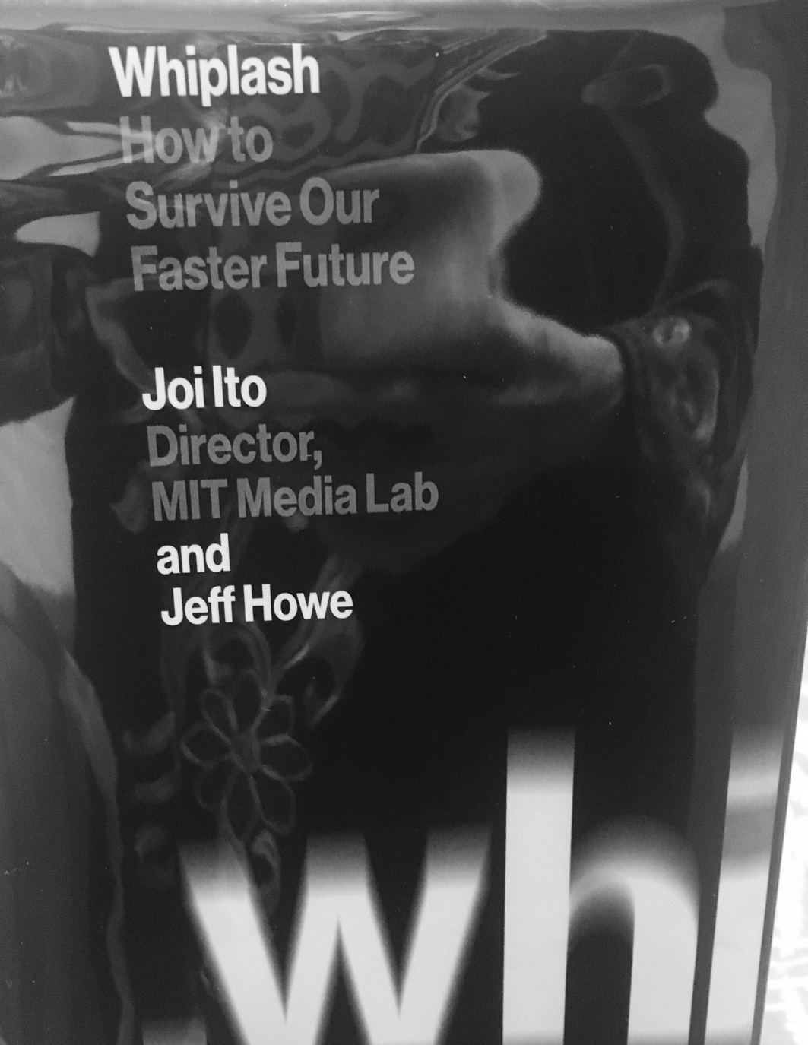
“…our current cognitive tool set leaves us ill-equipped to comprehend the profound implications posed by rapid advances in everything from communications to warfare.”

Slide 41
“In September 2014, every elementary and secondary student in a public school in the United Kingdom began studying computer programming. [Stuart Dredge, “Coding at School: A Parent’s Guide to England’s New Computing Curriculum,” Guardian, September 4, 2014, http://www.theguardian.com/technology/2014/sep/04/coding-school-computing-children-programming ] The U.S. government has thus far declined to institute such a blanket policy. But that could be changing.” (p. 166)

Slide 42
Other suggestions?

Slide 43
“In too many schools, teachers lack the time to learn new technology, or don’t have the institutional support to fully integrate it into the curriculum. One way of overcoming these issues is to invite subject-matter experts who are passionate about the technology to share their knowledge with the students, while the instructor oversees assessment and directs the conversation as necessary.” (p. 168)

Slide 44
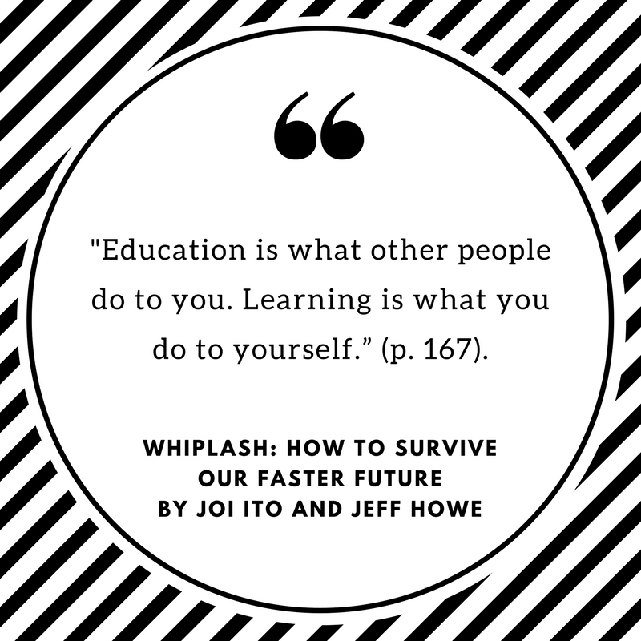

Slide 45
How NOT to be the Crazy Chicken!
Seek guidance from Islam
Acquire a grasp of research
Develop a vision and plan
Create strategies for implementation toward personal and professional reform
Spiritual
Physical
Emotional
Intellectual
X
X
X

Slide 46
Don’t be the Crazy Chicken!
Wholistic Needs of the Teachers
Or
Susan Labadi
Photo credit: Flickr Rob Bixby

Slide 47
What will you do to NOT be the Crazy Chicken?
Seek Allah’s Help and Be HIS Slave
Find Your Purpose
Set Your Intention
Take Care of Your Body and Mind
Protect Your Time From Disruption
Feed Your Intellect and Share
Encourage Learning For Students
DESIGN Your Life! Be Responsible!

Slide 48
SusanLabadi.com
Jazakum Allahu Kharirun

